Slide 1
Graph Contrastive Learning with Cohesive Subgraph Awareness
https://github.com/wuyucheng2002/CTAug
（WWW-2024)
Reported by Ke Gan

Slide 2
1. Introduction
2. Approach
3. Experiments

Slide 3
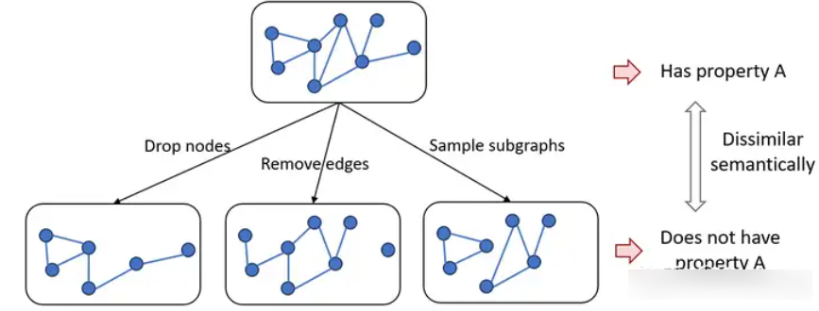
Introduction
such augmentations may severely damage the intrinsic properties of a graph and deteriorate the representation learning process.
nodes and edges usually hold diverse levels of importance in a graph, leveraging the intrinsic properties of a graph to guide the graph augmentation of GCL
introduce cohesive subgraphs to guide topology augmentations

Slide 4
Introduction
cohesive subgraphs are densely connected subsets of important nodes in a graph
𝑘-core is a maximal subgraph in which every node has at least 𝑘 links to the other nodes
𝑘-truss is the largest subgraph in which every edge is in at least (𝑘 − 2) triangles of the subgraph

Slide 5
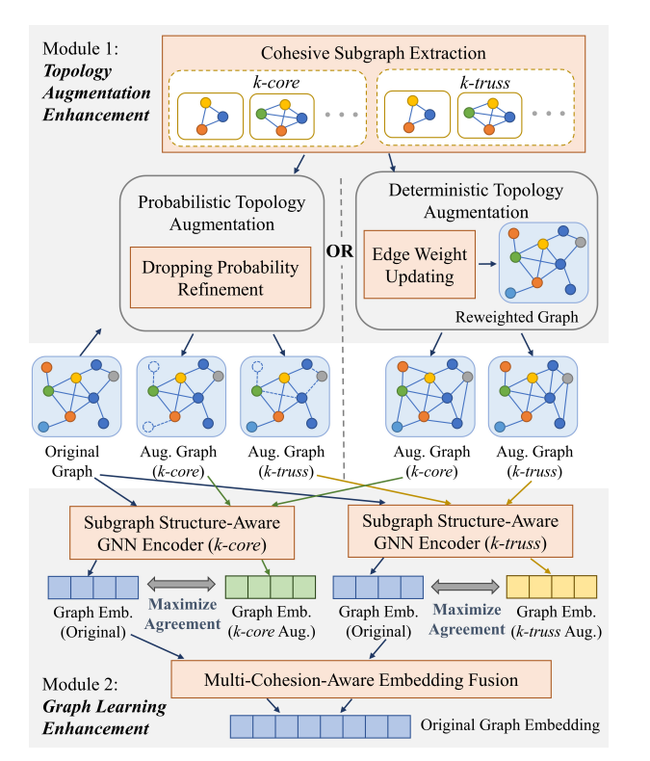
Approach

Slide 6
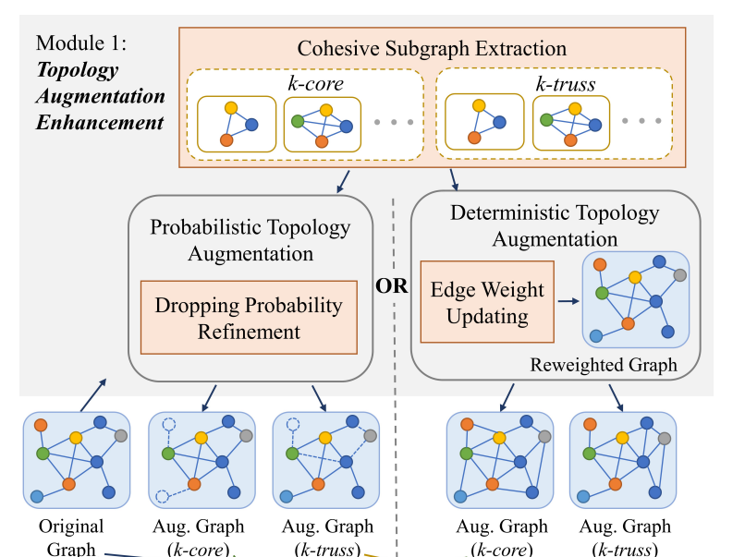
Approach

Slide 7
Approach

Slide 8
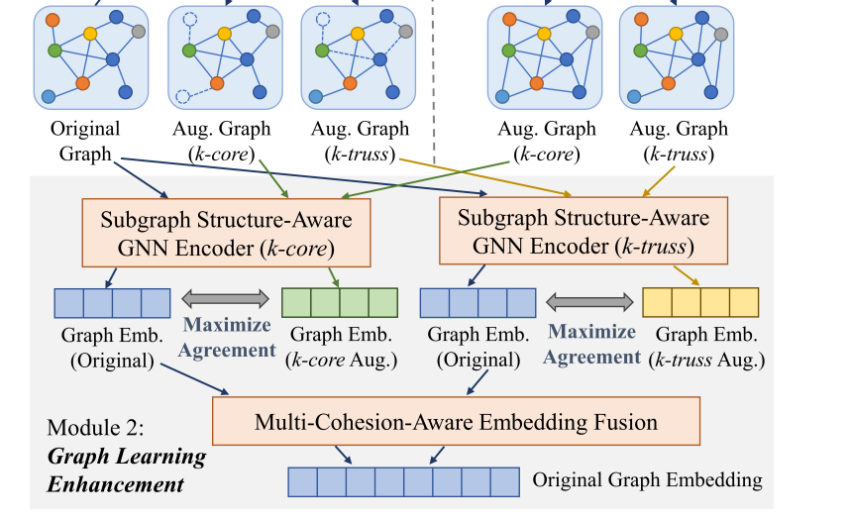
Approach

Slide 9
Experiment

Slide 10
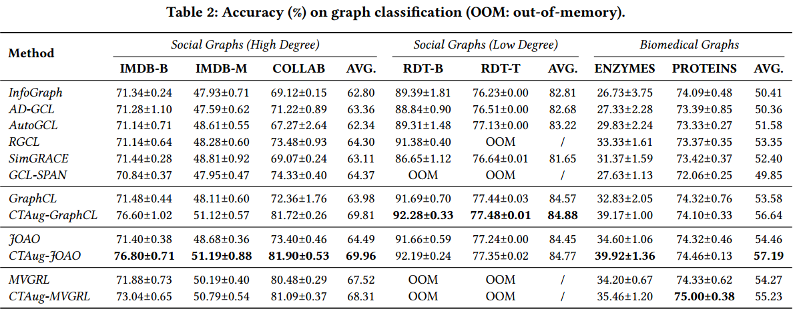
Experiment

Slide 11
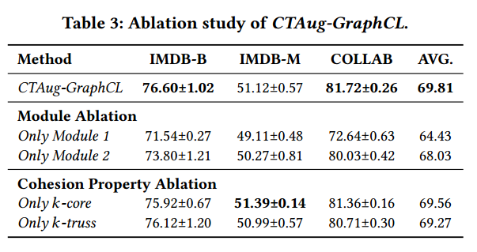
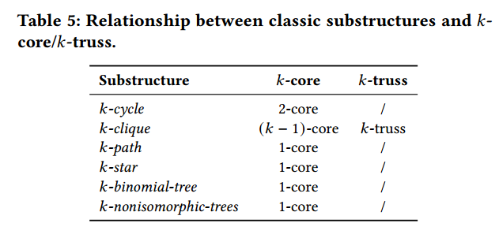
Experiment

Slide 12
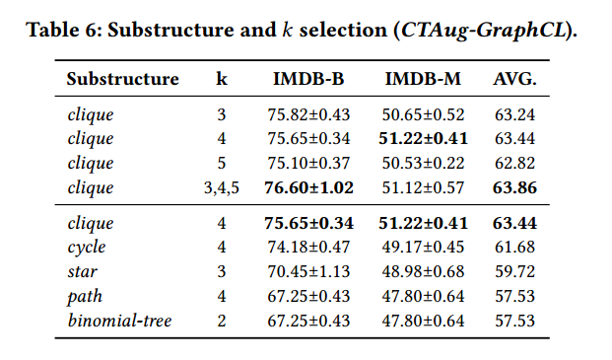
Experiment

Slide 13
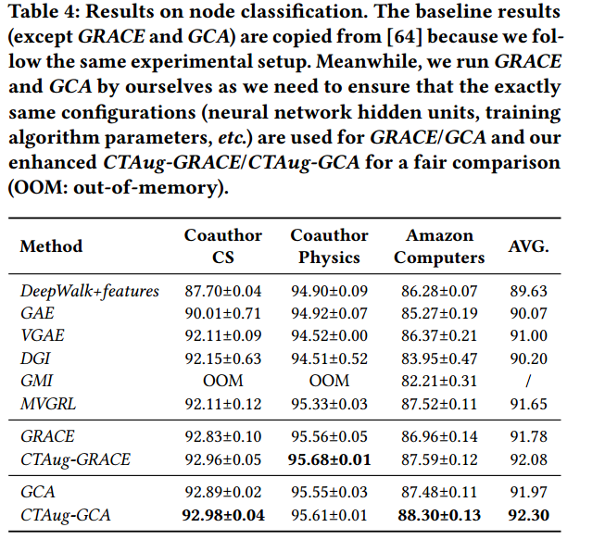
Experiment

Slide 14
Thank you!

